Slide 1
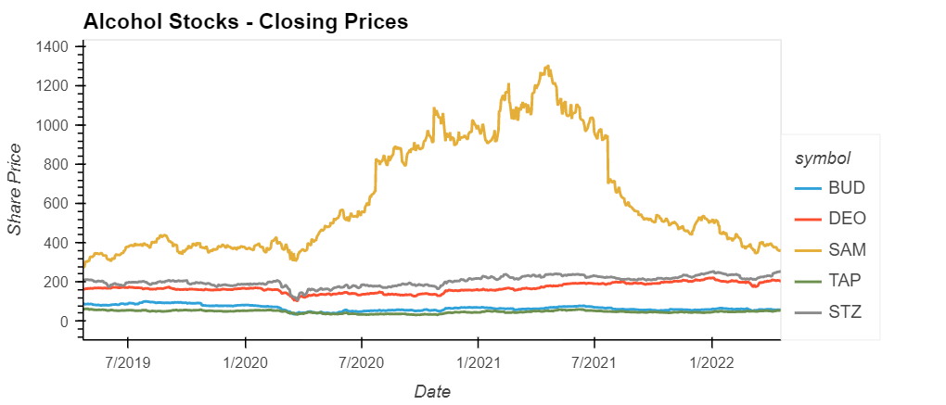
df_alc_data.hvplot( xlabel = "Date", ylabel = "Share Price", label = "Alcohol Stocks - Closing Prices" )

Slide 2
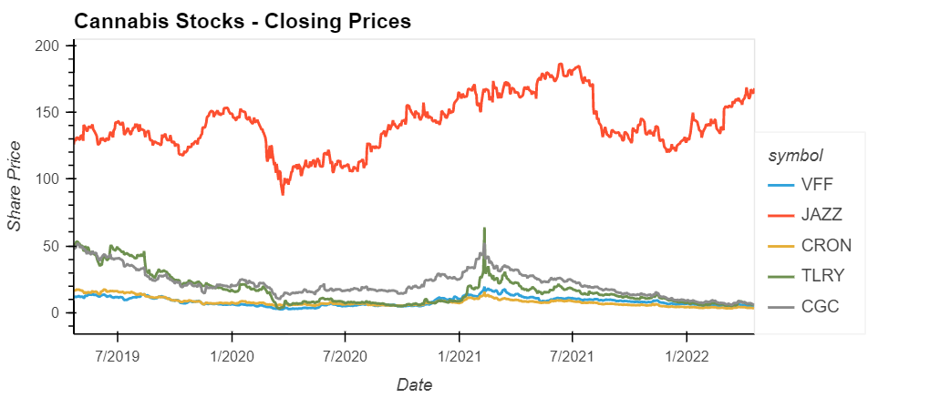
df_cann_data.hvplot(
xlabel = "Date",
ylabel = "Share Price",
label = "Cannabis Stocks - Closing Prices"
)

Slide 3
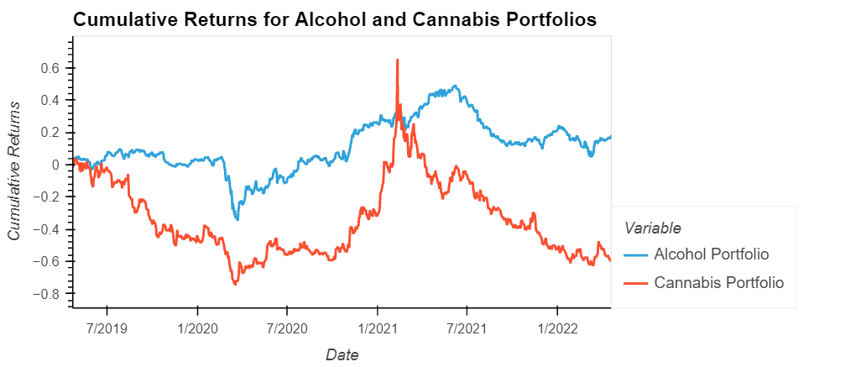
combined_returns = pd.concat([alc_portfolio_returns, cann_portfolio_returns],axis="columns", join= "inner")
combined_returns.columns= ["Alcohol Portfolio", "Cannabis Portfolio"]
combined_returns.dropna()

Slide 4
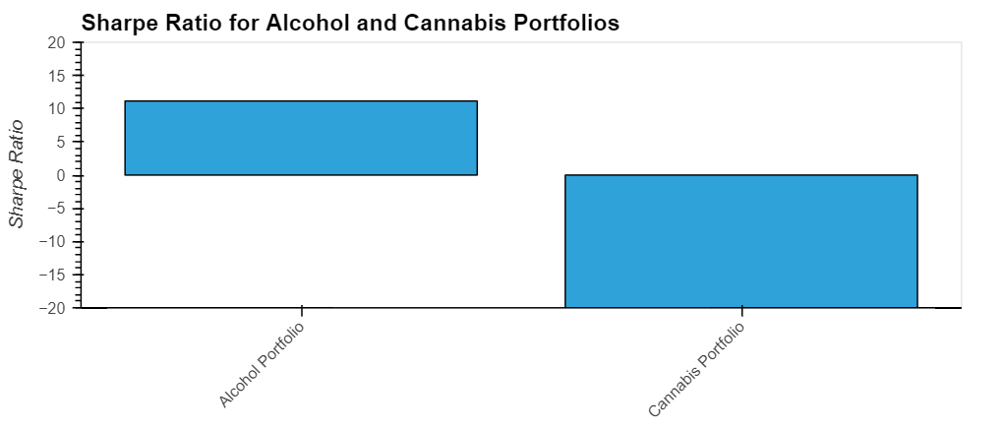
sharpe_ratio = (cumulative_returns.mean() * 252) / (cumulative_returns.std() *np.sqrt(252))
sharpe_ratio

Slide 5
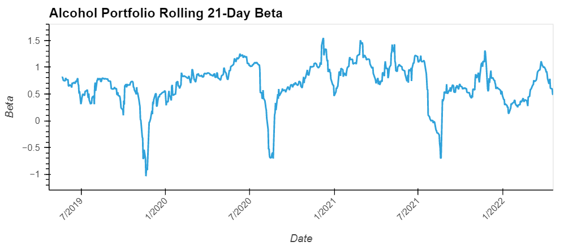
TITLE HEREcov1 = bench_cann_alc["Alcohol Portfolio"].rolling(window=21).cov(bench_cann_alc["S&P 500 Portfolio"])
var1 = bench_cann_alc["S&P 500 Portfolio"].rolling(window=21).var()
beta1 = cov1 / var1

Slide 6
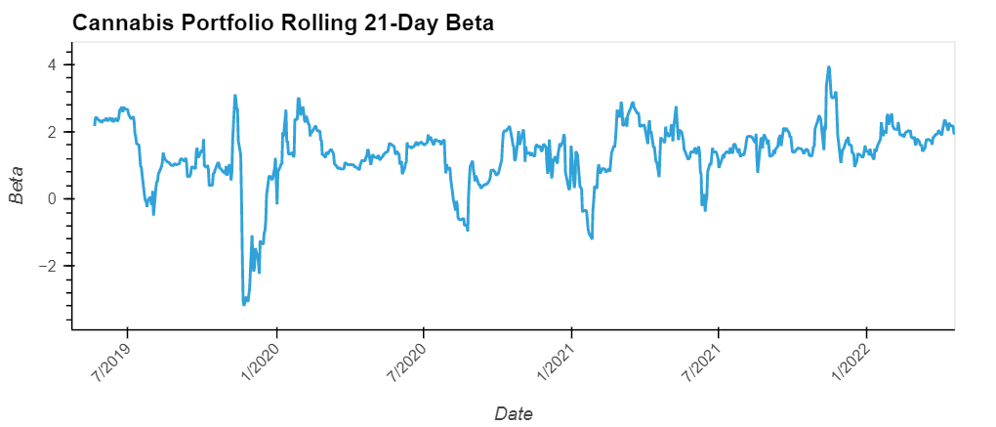
cov2 = bench_cann_alc["Cannabis Portfolio"].rolling(window=21).cov(bench_cann_alc["S&P 500 Portfolio"])
var2 = bench_cann_alc["S&P 500 Portfolio"].rolling(window=21).var()
beta2 = cov2 / var2

Slide 7
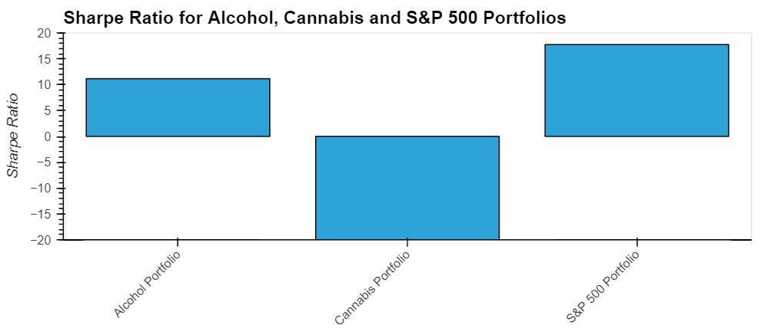
bench_sharpe_ratio = (bench_cann_alc.mean() * 252) / (bench_cann_alc.std() *np.sqrt(252))
bench_sharpe_ratio

Slide 8
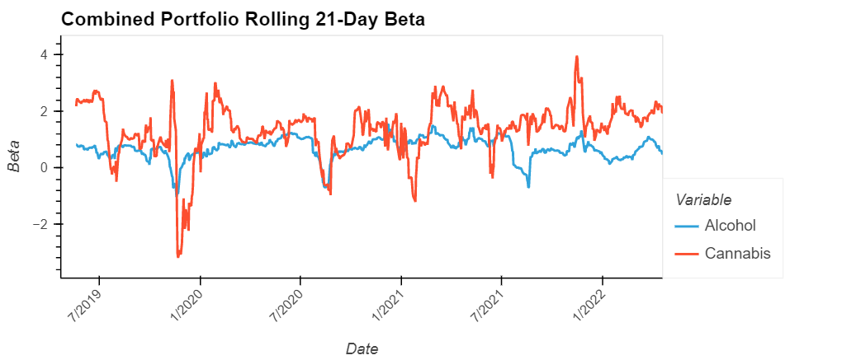
rolling_beta_combined =pd.concat([beta1, beta2], axis="columns")
rolling_beta_combined.rename(columns={ 0 :"Alcohol", 1 :"Cannabis" }, inplace=True)
rolling_beta_combined.hvplot(
xlabel = "Date",
ylabel = "Beta",
label = "Combined Portfolio Rolling 21-Day Beta",
rot=45
)

Slide 9
Definitions and referential visualizations
https://www.investopedia.com/terms/s/sharperatio.asp#toc-what-is-a-good-sharpe-ratio
https://www.investopedia.com/investing/beta-know-risk/#:~:text=A%20stock%20that%20swings%20more,risk%20but%20also%20lower%20returns.
https://www.investopedia.com/terms/c/cumulativereturn.asp
https://www.investopedia.com/articles/investing/122215/spy-spdr-sp-500-trust-etf.asp
https://public.tableau.com/app/profile/victor.d.pr./viz/shared/P8XMKYCX5
https://public.tableau.com/app/profile/ashishbidap/viz/CannabisMarketAnalysis-COMA-Dashboard/Dashboard1

Slide 10
Alcohol Stock Investor Relations Links
BUD: Anheuser-Busch
DEO: Diageo
SAM: The Boston Beer Company
TAP: Molson Coors Beverage Company
STZ: Constellation Brands

Slide 11
Cannabis Stock Investor Relations Links
VFF: Village Farms International
JAZZ: Jazz Pharmaceuticals
CRON: The Cronos Group
TRLY: Tilray Brands
CGC: Canopy Growth

Slide 12
Documentation
Python: https://docs.python.org/3/
Pandas: https://pandas.pydata.org/pandas-docs/stable/
HVPlot: https://hvplot.holoviz.org/
Pickle: https://docs.python.org/3/library/pickle.html
Alpaca Trade API: https://alpaca.markets/docs/
Matplotlib: https://matplotlib.org/

Slide 13
Drink Up?
or
Up in SMOTE?
Project 2:
Exploration of Various Machine Learning Models to Assist in the Analysis and Prediction of Alcohol and Cannabis Sector Equity Predictions
Team:
Karen Garcia, Michael Foley, Jason Raeppold

Slide 14
“Using animals in experiments?
Normally we’d be against it.”
(Harold, Theresa. “What happens if you let a robot name your guinea pigs?”. June, 2017)

Slide 15
Machine Learning: Trading Algo
> Create and Evaluate Long and Short Models
> Cannabis underperformed Alcohol Sector Stocks (and SP500), so the expectation was build long trading model for Alcohol and short trading model for Cannabis

Slide 16
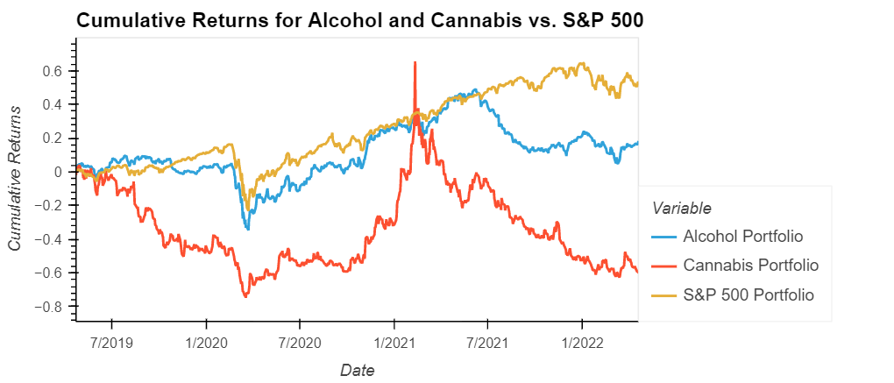
bench_cumulative_returns = (1 + bench_cann_alc).cumprod() - 1
bench_cumulative_returns.hvplot(
ylabel = "Cumulative Returns",
xlabel = "Date",
label = "Cumulative Returns for Alcohol and Cannabis vs. S&P 500"
)

Slide 17
Long Algo: BUD

Slide 18
Training Report: BUD

Slide 19
BUD - Testing Report

Slide 20
Short Algo: VFF

Slide 21
Training Report: VFF

Slide 22
Testing Report: VFF

Slide 23
Window Size: 2

Slide 24
LSTM Model 1: Compares Alcohol Stock Data to SP500- Parameters had to be adjusted continuously to produce a good model. Results were mostly underfit; however, I was able to get a slightly better model by reducing the window size.

Slide 25
Window Size 2: Real vs Predicted

Slide 26
Window Size: 10

Slide 27
LSTM Model 2: Compares Cannabis Stock Data to SP500- the model did perform well with a window size of 10 with slight adjustments to the parameters.

Slide 28
Window Size 10: Real vs Predicted

Slide 29
Random Forest: Regression
rf_model = RandomForestRegressor(n_estimators=500, max_depth=5, max_features=4, random_state=42)
rf_model.fit(X_train, y_train)

Slide 30
Random Forest Regression: Results
Root Mean Squared Error:
0.15129541483527212
\
Mean Absolute Error: 0.1321208757630471
Mean Squared Error:
0.022890302550177075

Slide 31
Linear Regression
jr_model = LinearRegression()
jr_model.fit(X_train, y_train)
predictions = jr_model.predict(X_test)
Root Mean Squared Error: 13.170028591642202
Mean Absolute Error: 10.42933799958384
Mean Squared Error: 173.4496531046731

Slide 32
Project 2 - Scope
Project 1
> Financial Analysis > Ratios and Rolling Averages
> Comparative Portfolio Analysis
>Risk vs Reward Focus
Project 2
> Machine Learning
> Multiple Models > Scalable and Tunable > Better Understand Risk vis a vis Sharpe Ratio Volatility

Slide 33
Libraries
Tensorflow KerasTensorflow KerasYfinance
Talib
Numpy
Pandas
Matplotlib
Sklearn
Seaborn
Math
Yfinance

